Slide 1
Shift register

Slide 2
Register
A register is a digital circuit with two basic functions : Data storage and Data Movement
A shift register provides the data movement function
A shift register “shifts “ its output once every clock cycle.

Slide 3
SHIFT REGISTER
A shift register is a group of flip flop set up in a linear function with their inputs and outputs are connected together is such a way that the data shifted from one device to another when the circuit is active
D flip flop is used for shift register

Slide 4
Characteristics
Types
SISO (serial in serial out)
SIPO( serial in parallel out)
PISO (parallel in serial out)
PIPO(parallel in parallel out)
Direction
Shift left
Shift right
Bidirectional Shift
Unidirectional Shift

Slide 5
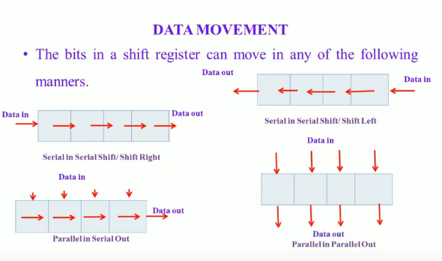
How the data movement takes place

Slide 6
SISO (serial in serial out)
Data bits come in one at a time and leave one at a time
One flip flop for each bit to be handled
Movement can be left or right , but is usually only in a single direction in a given register

Slide 7
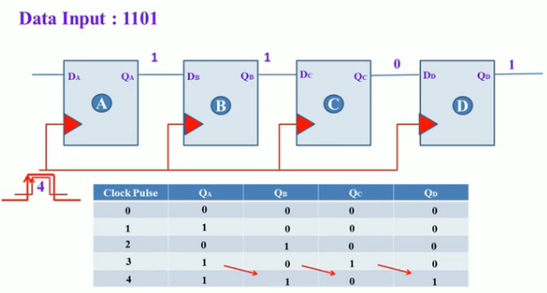
Cont.

Slide 8
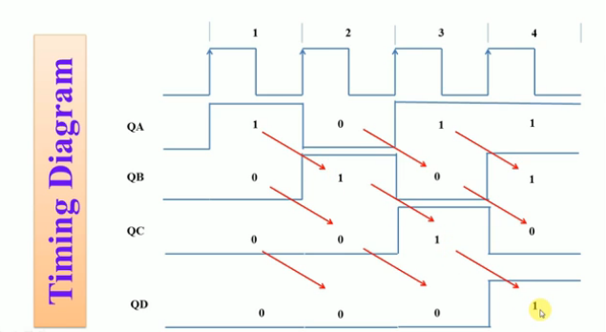

Slide 9
SIPO( serial in parallel out)
We often need to convert from serial to parallel
Ex. After receiving a series transmission
We would use a SIPO shift register of length N to convert an N –Bit word from serial to parallel
It would require N clock pulse to LOAD and one clock pulse to UNLOAD

Slide 10
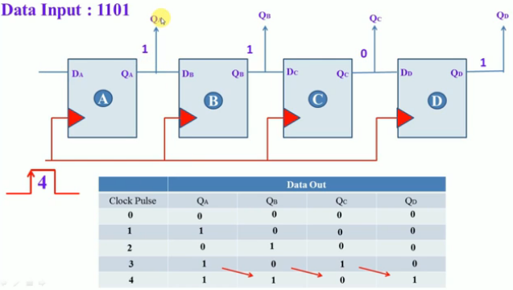
Cont.

Slide 11
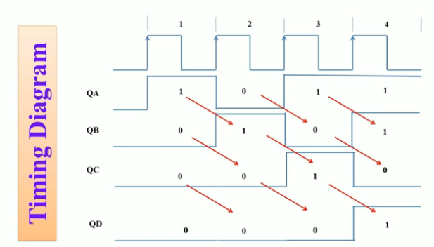
Timing diagram

Slide 12
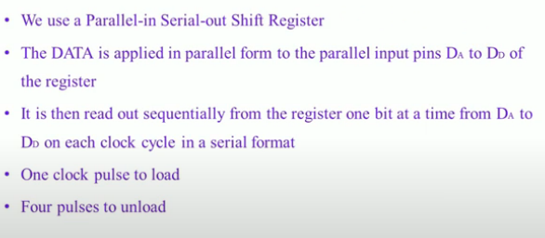
PISO (parallel in serial out)

Slide 13
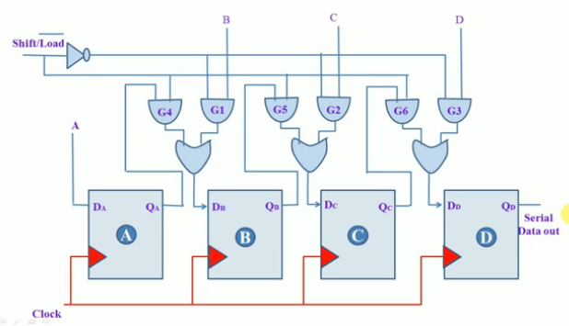
Cont.

Slide 14
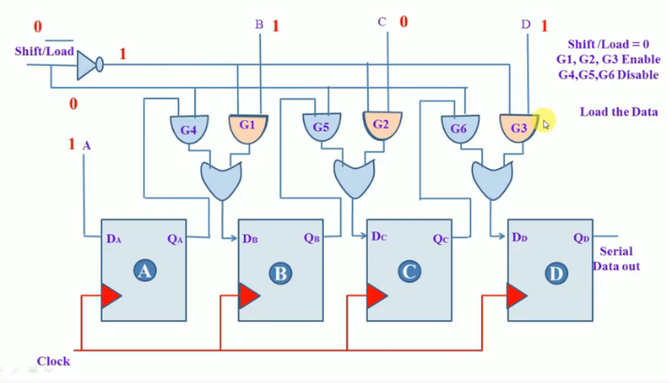
Cont.

Slide 15
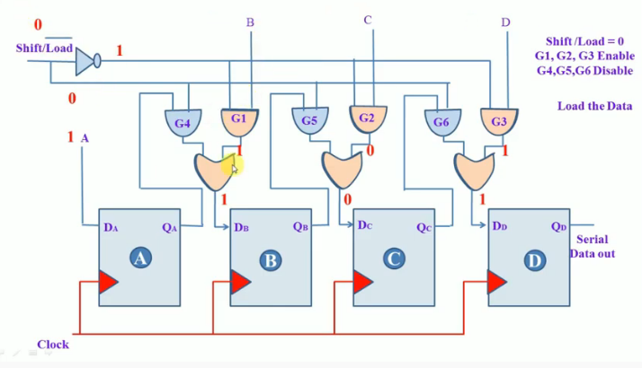
Cont.

Slide 16
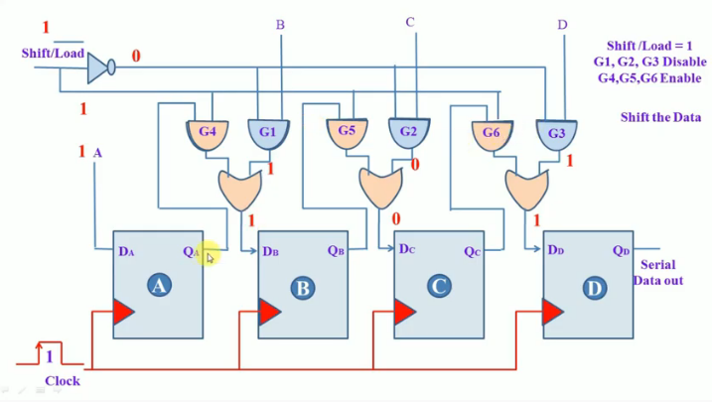

Slide 17
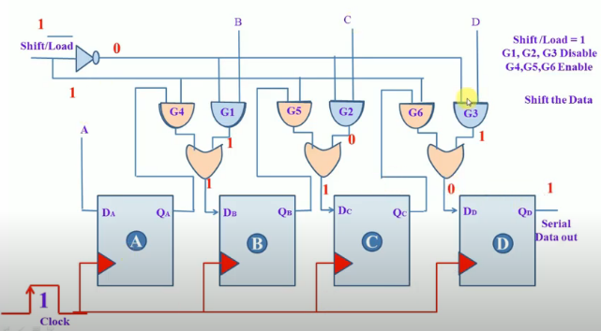
Cont.

Slide 18
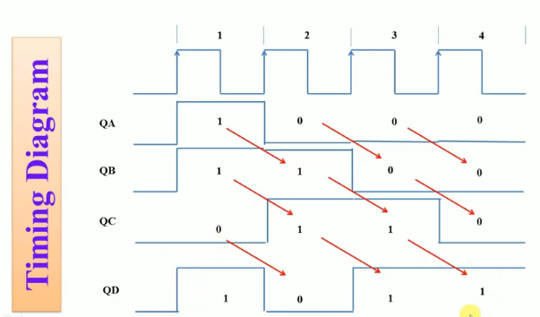
Timing diagram

Slide 19
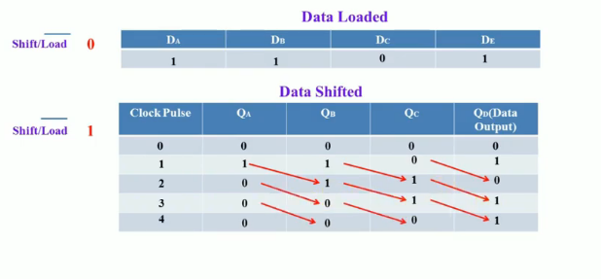
Data shifting

Slide 20
PIPO(Parallel in parallel out)
PIPO shift register can serve as a temporary storage device or as a time delay device
The date is presented in a parallel format to the parallel input pin Da to Dd and then shifted to the corresponding output pins Qa to Qd when the registers are clocked
One clock pulse is used to load

Slide 21
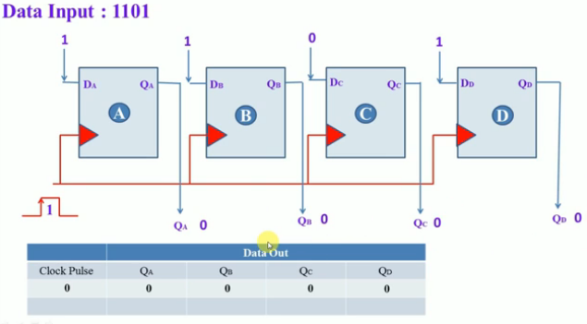
Cont.

Slide 22
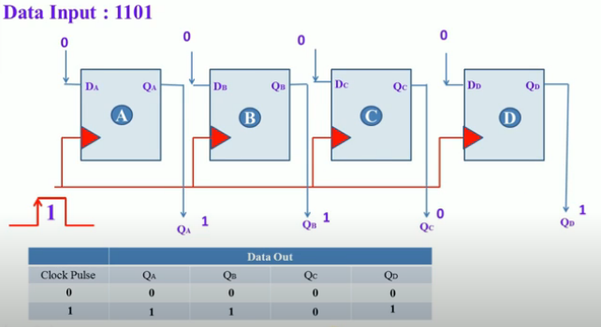
Cont.

Slide 23
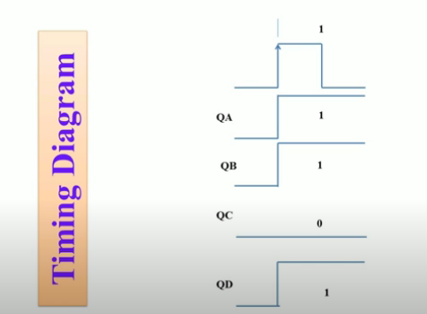
Timing diagram

Slide 24
Application of Shift Register
It is often used is data communication such as-
Modern transmission and reception
Ethernet links- Local area network (LAN)
SONET (Synchronous optical network) –a optical fiber, etc

Slide 25
THANK YOU

